Slide 1



NANOSKILLSLEARNING WEBSITE

Slide 2
NANOSKILLSLEARNING WEBSITE
CAPSTONE PROJECT PRESENTATION 卒業論文プレゼンテーション
Hanoi, December 21th, 2017

Slide 3






ABOUT US
- NSL Team -
We are final year students of FPT University. With the tutorial of Mr.Phan Truong Lam,
we had successfully built this project
Phan Truong Lam
Supervisor
Do Thien Huynh
Member
Dao Anh Tuan
Member
Le Tuan Anh
Leader
Nguyen Tuan Tung
Member
Pham Viet Cuong
Member

Slide 4
Introduction イントロダクション
1
Software Project Management
プロジェクト管理
2
3
Software Requirement Specification
ソフトウェア要件仕様書
Software Design Description
ソフトウェア 設計書
Outline
アウトライン
4
Software Testing
ソフトウェアテスト
5
Lesson Learn
学んだ教訓
6
7
Demo - デモ
8
Q & A - 質問と回答

Slide 5

INDTRODUCTION イントロダクション

Slide 6

INTRODUCTION

Slide 7

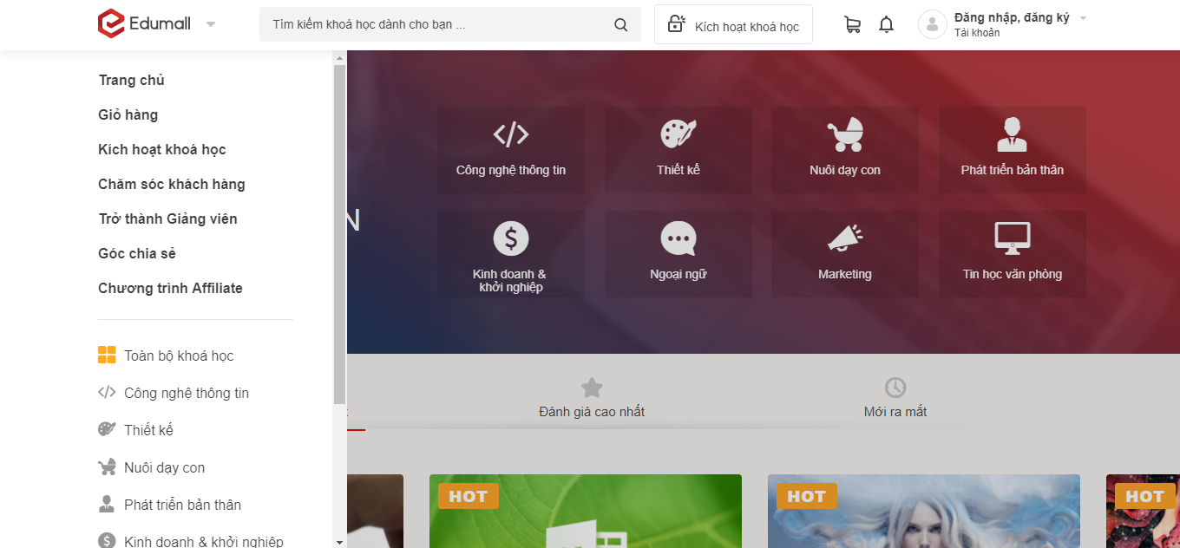
INTRODUCTION
Existing system
EDX Website (https://www.edx.org)
EDUMALL Website (https://edumall.vn)

Slide 8

INTRODUCTION
IDEA
“Nanoskillslearning website” branding the e-learning image, offering customers with a time-saving and efficient study way.

Slide 9
9
PROJECT MANAGEMENT プロジェクト管理

Slide 10
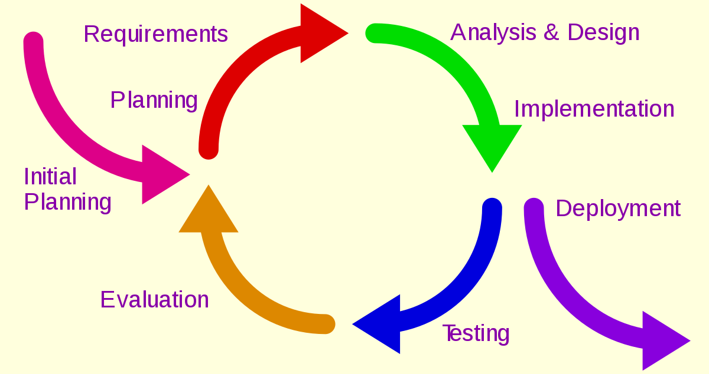
PROJECT MANAGEMENT
Software development process
フトウェア開発のプロセス
Iteration 1: Sep 05th – Dec 14th
Iterative Model

Slide 11
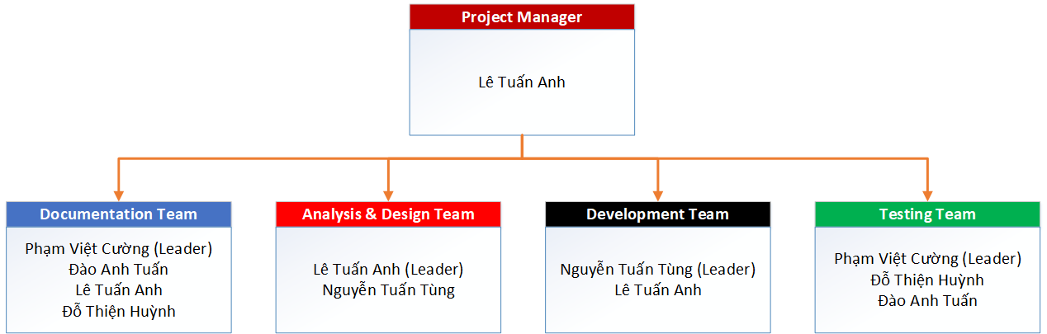
PROJECT MANAGEMENT
Organizational Structure - 組織構造

Slide 12
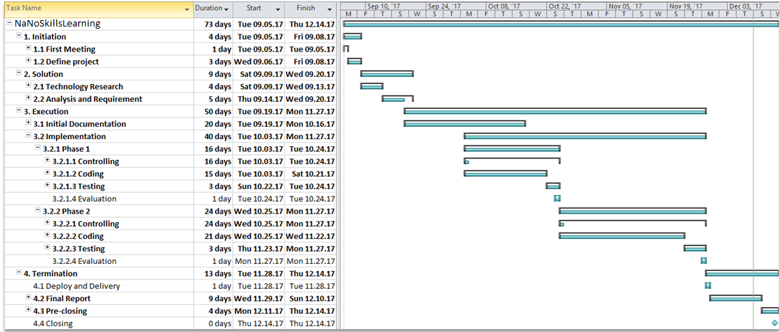
PROJECT MANAGEMENT
Project Schedule - プロジェクトスジュール

Slide 13



PROJECT MANAGEMENT
Project Tools – プロジェクトツール
Tools for project management
Github
Dropbox
Google Drive

Slide 14





PROJECT MANAGEMENT
Project Tools – プロジェクトツール
Tools for developing
MySQL
Astah
Google Chrome
Web Storm
Sublime Text

Slide 15
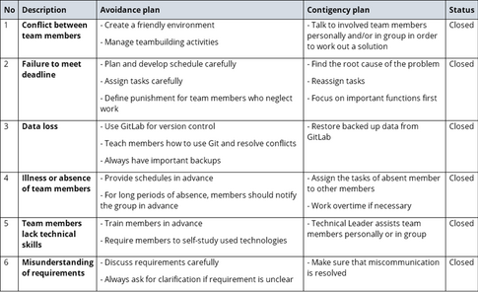
PROJECT MANAGEMENT
Risk Management - リスク管理

Slide 16




PROJECT MANAGEMENT
Communication management - コミュニケーション管理
Time: 6 hours/day, 5 days/week.
Location: Alpha building, room 313R, FPT University Hoa Lac
Communication:
Supervisor meeting: Once a week

Slide 17

SOFTWARE REQUIREMENT SPECIFICATION ソフトウェア要件仕様書

Slide 18
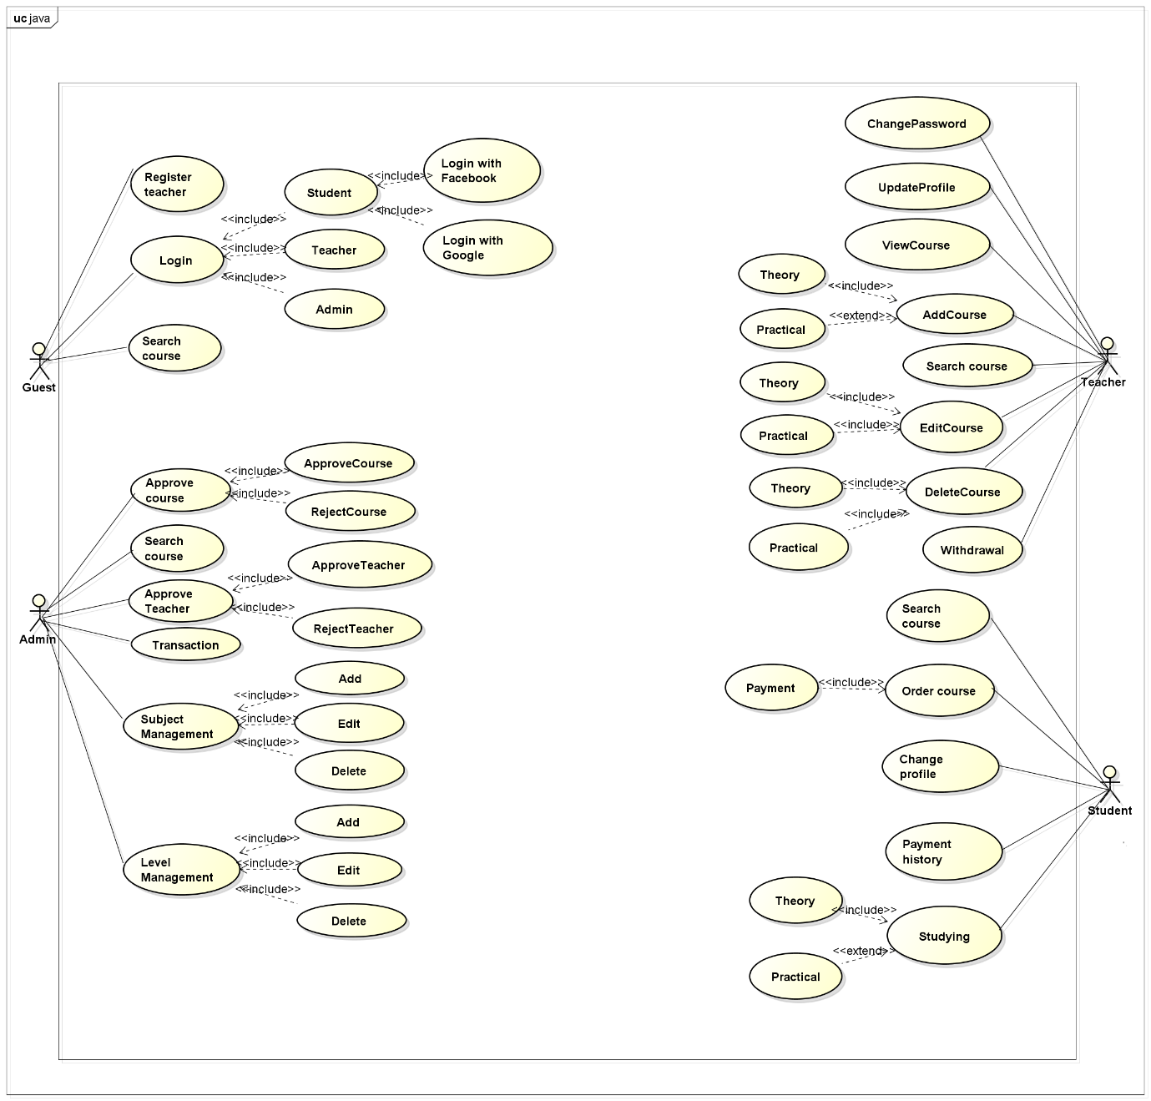
Software Requirement Specification
Use-cases overview:
Guest
Student
Teacher
Admin

Slide 19
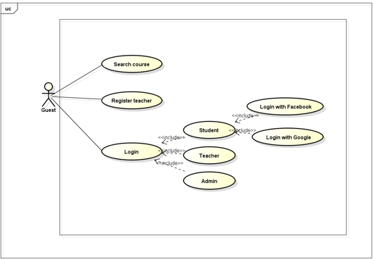

Software Requirement Specification
Guest
Guest use case diagram

Slide 20
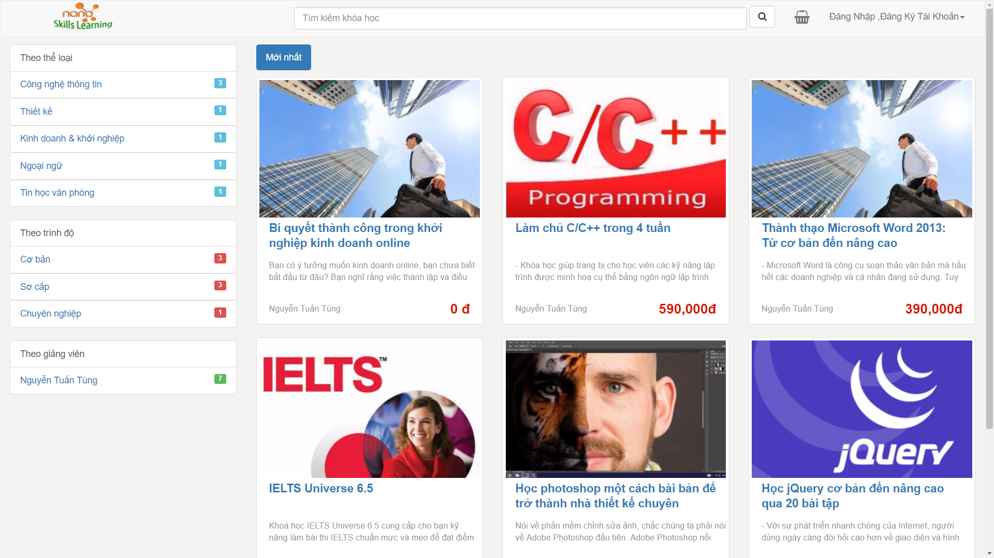
Software Requirement Specification
Guest
Home screen

Slide 21
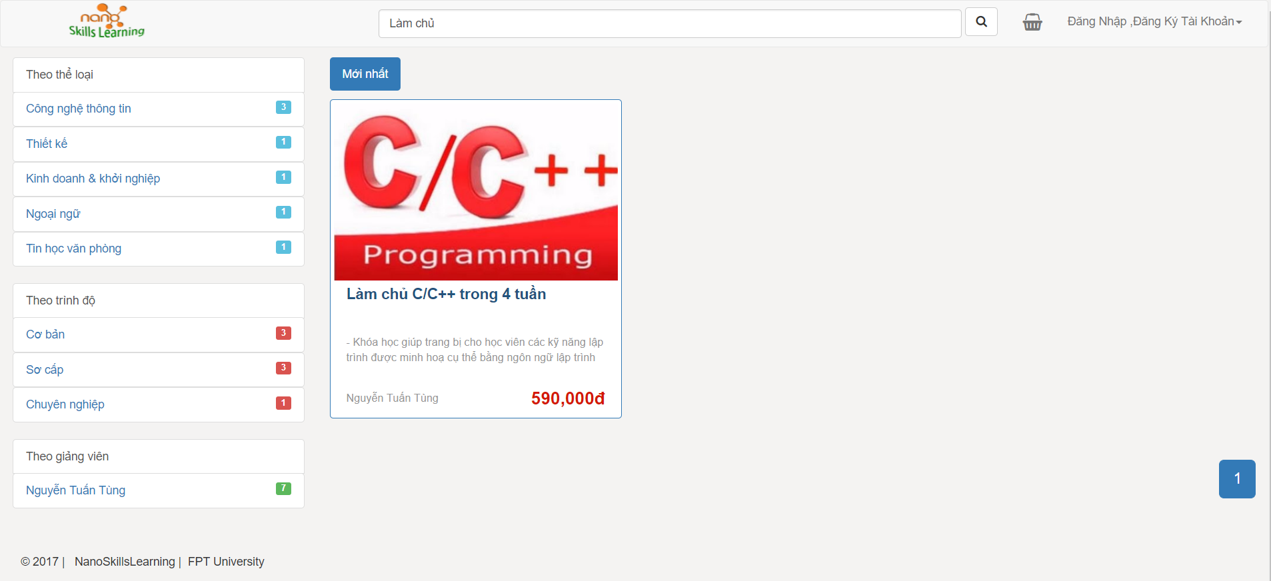
Software Requirement Specification
Guest
Search by keyword

Slide 22
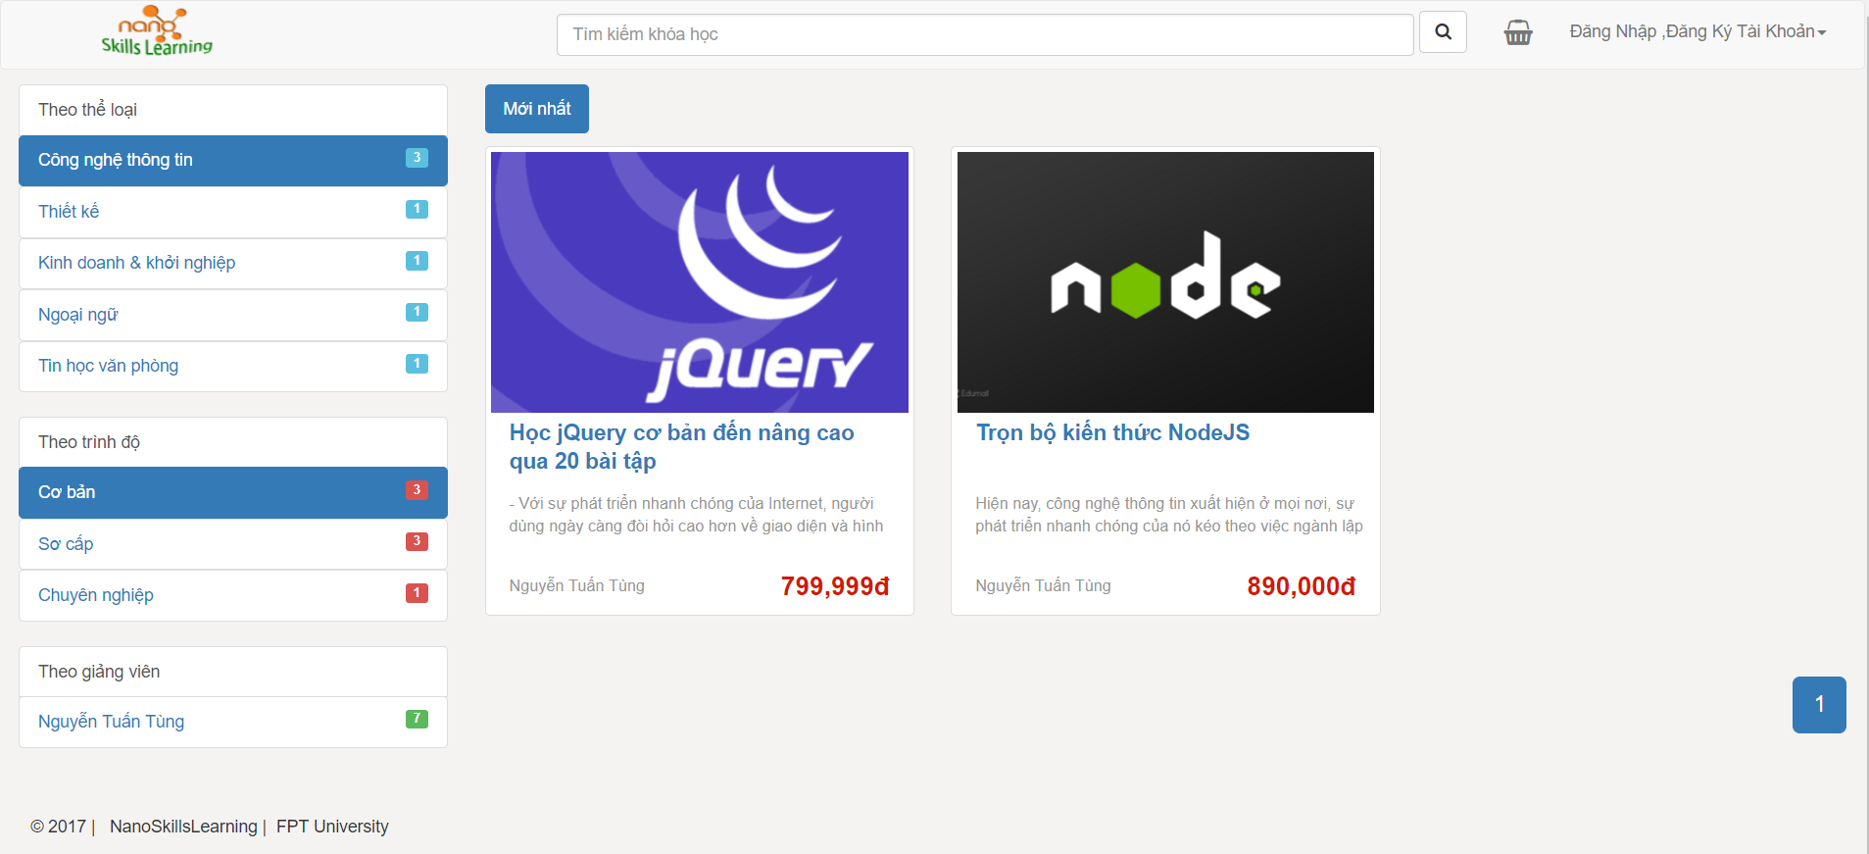
Software Requirement Specification
Guest
Search by category, level, teacher

Slide 23
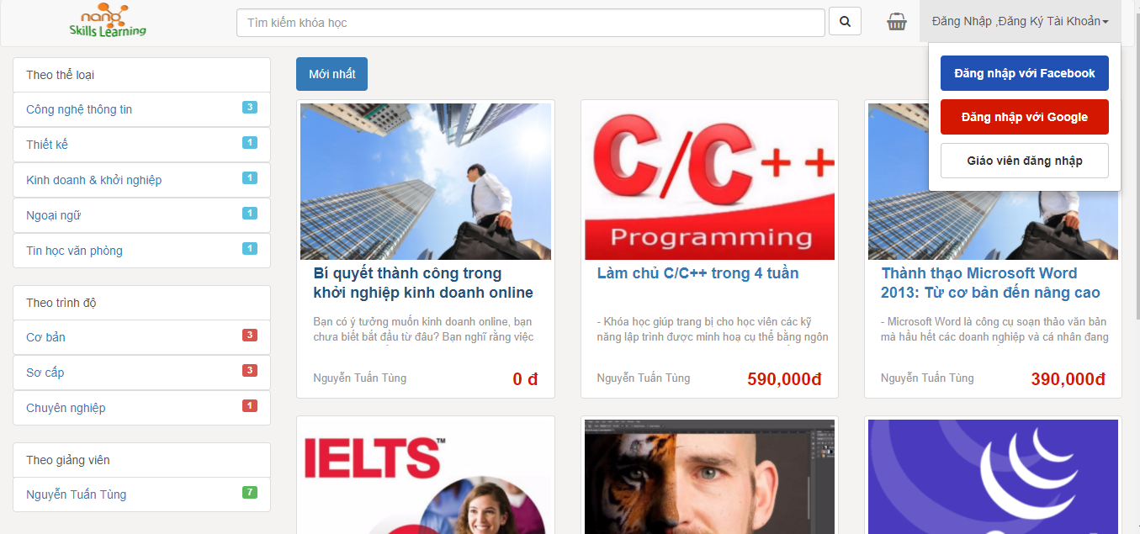
Software Requirement Specification
Guest
Log in tool

Slide 24
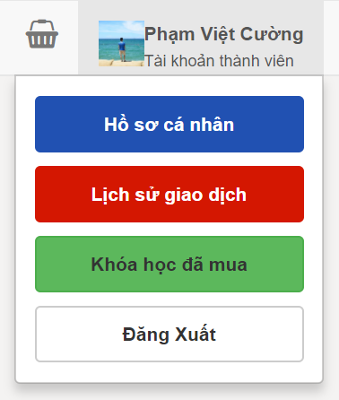
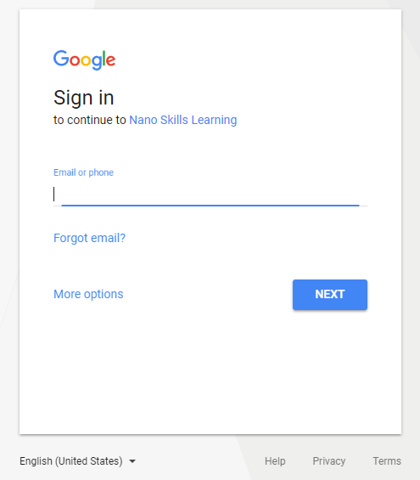
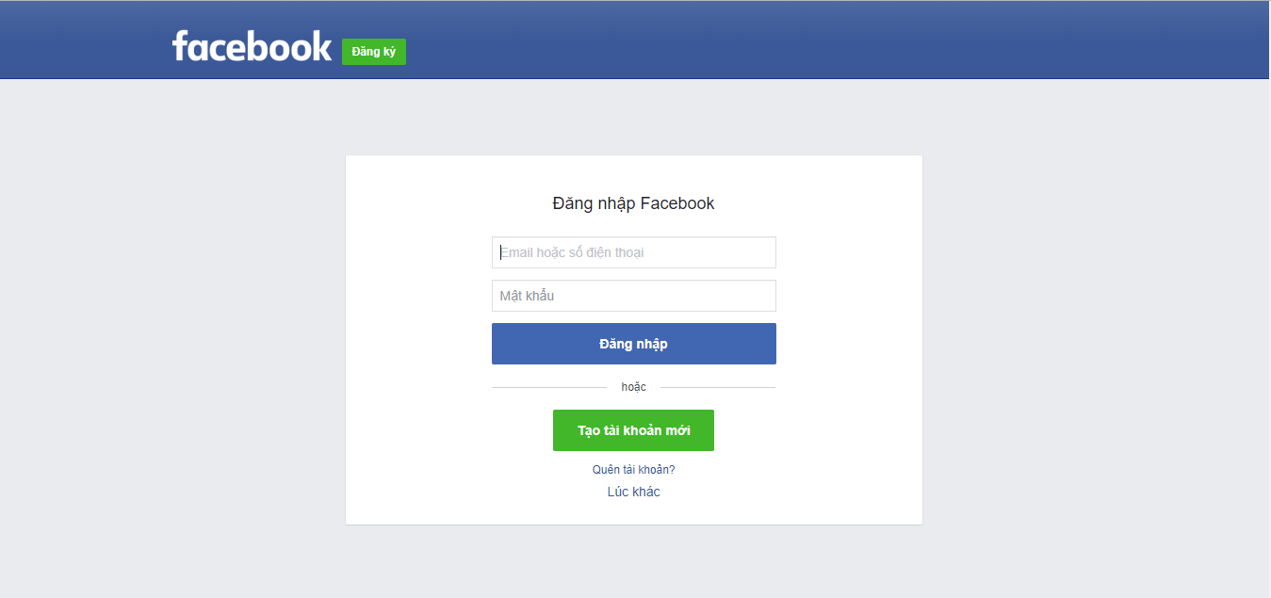
Software Requirement Specification
Guest
Login student

Slide 25
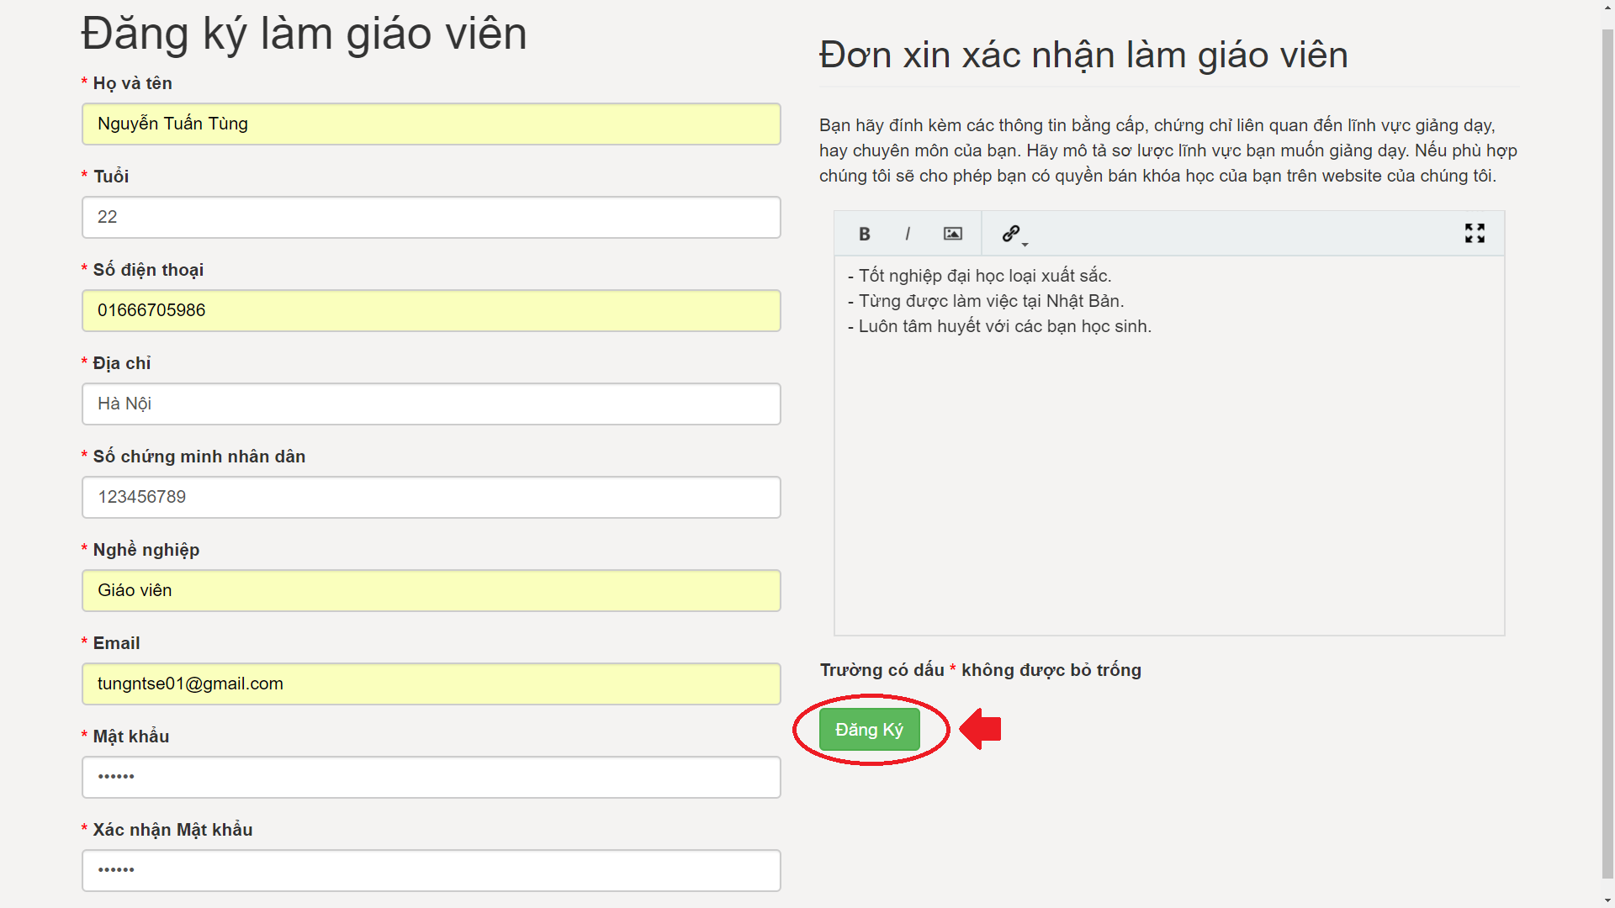
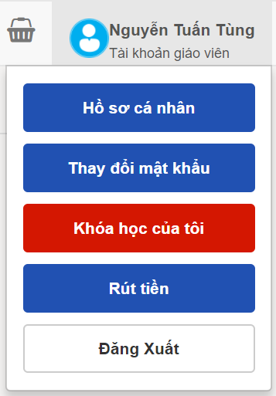
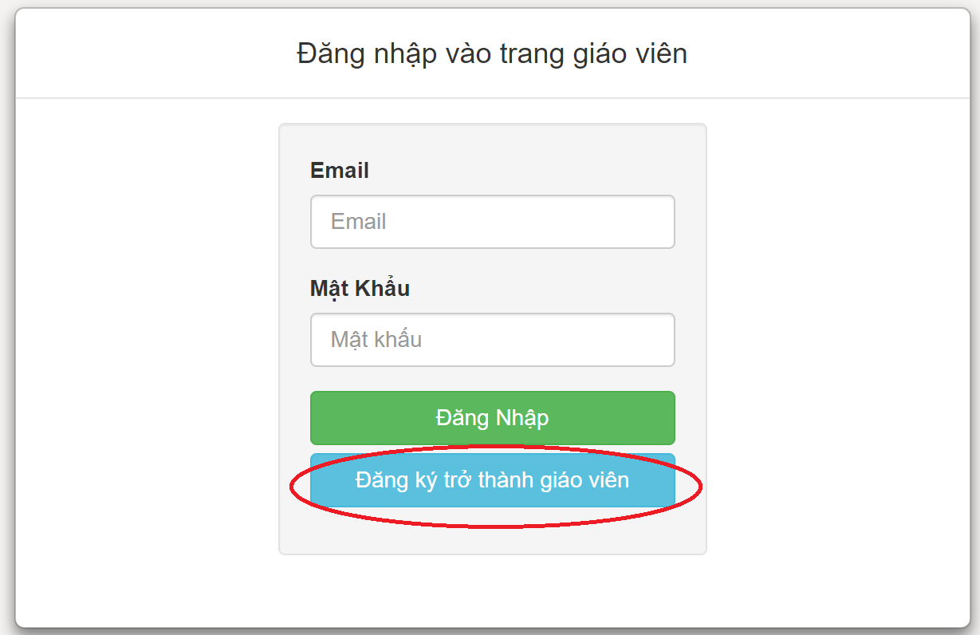
Software Requirement Specification
Guest
Login or Register teacher

Slide 26
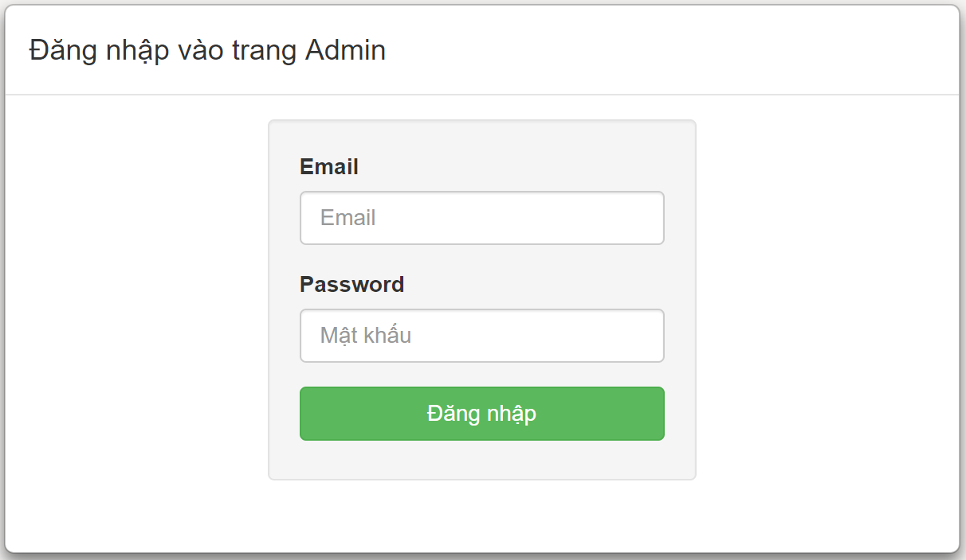
Software Requirement Specification
Guest
Login admin (http://nanoskillslearning.com/admin)

Slide 27
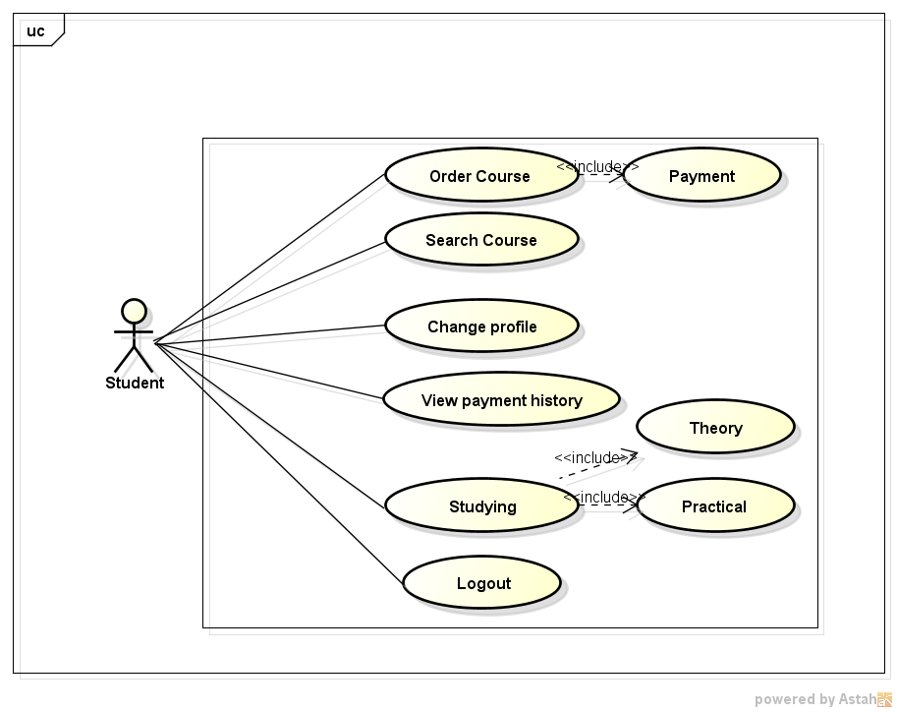
Software Requirement Specification
Student
Student use case diagram

Slide 28
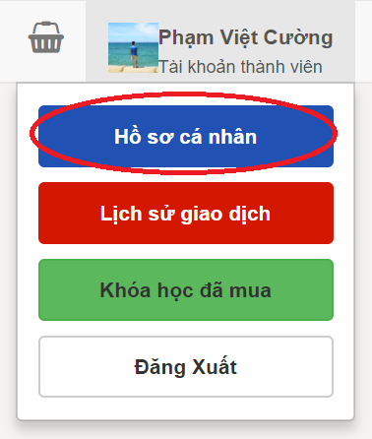
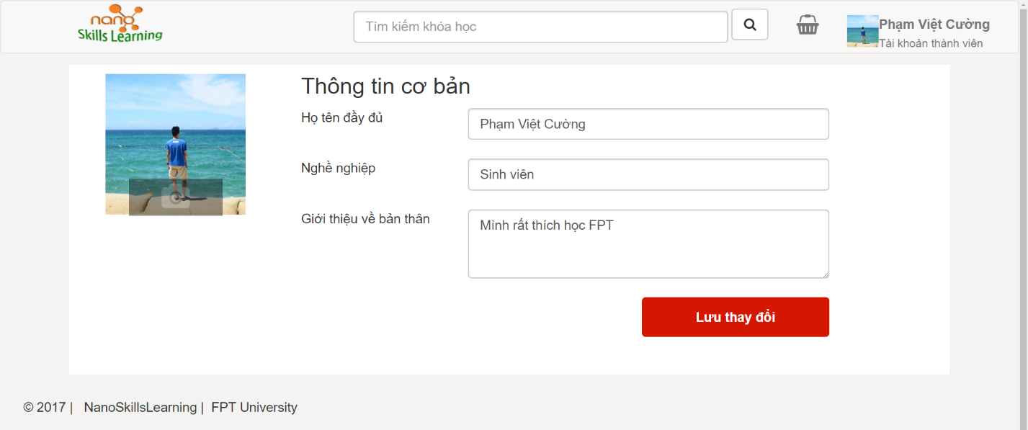
Software Requirement Specification
Student
Student’s profile

Slide 29
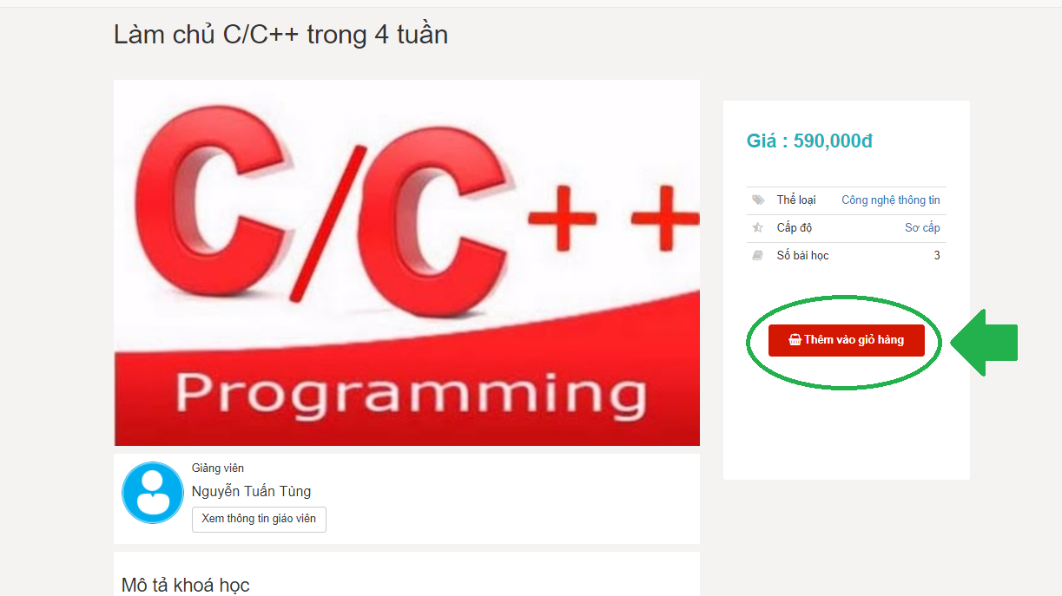
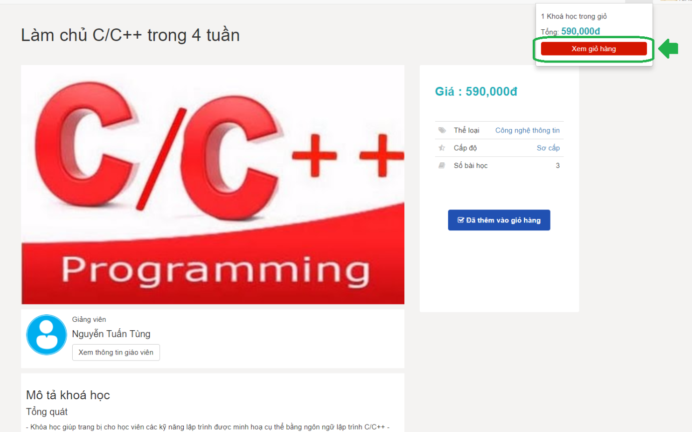
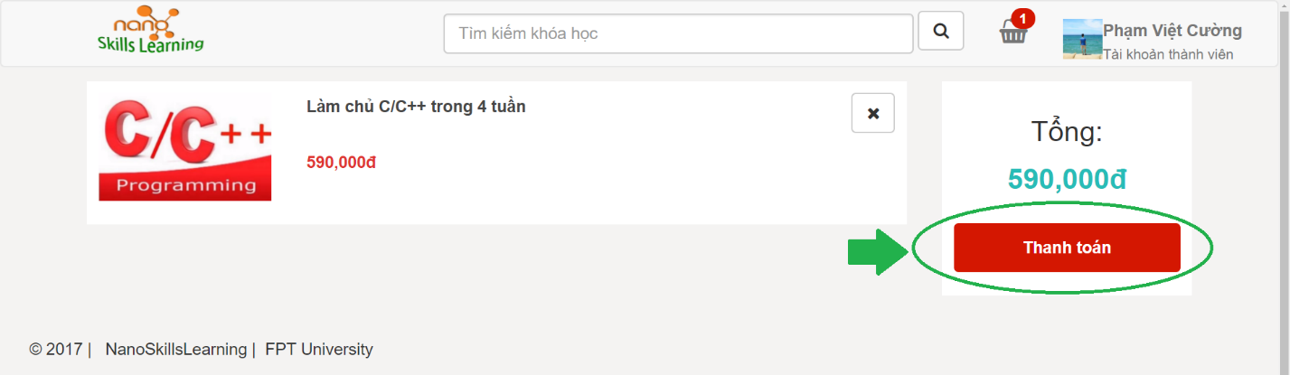
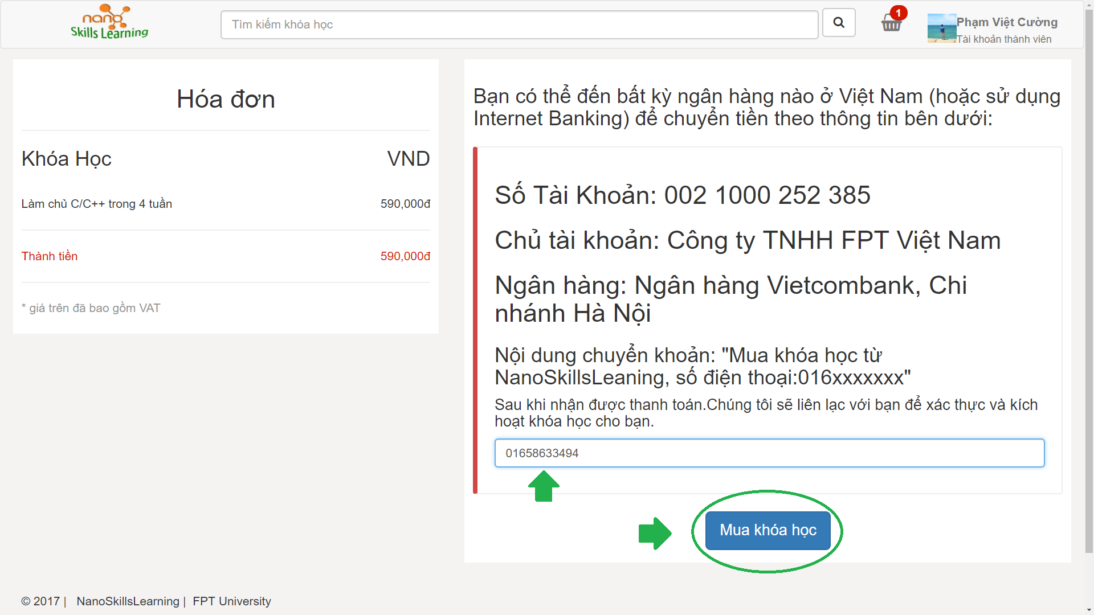
Software Requirement Specification
Student
Student order course

Slide 30
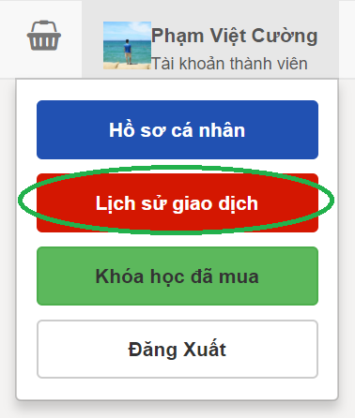
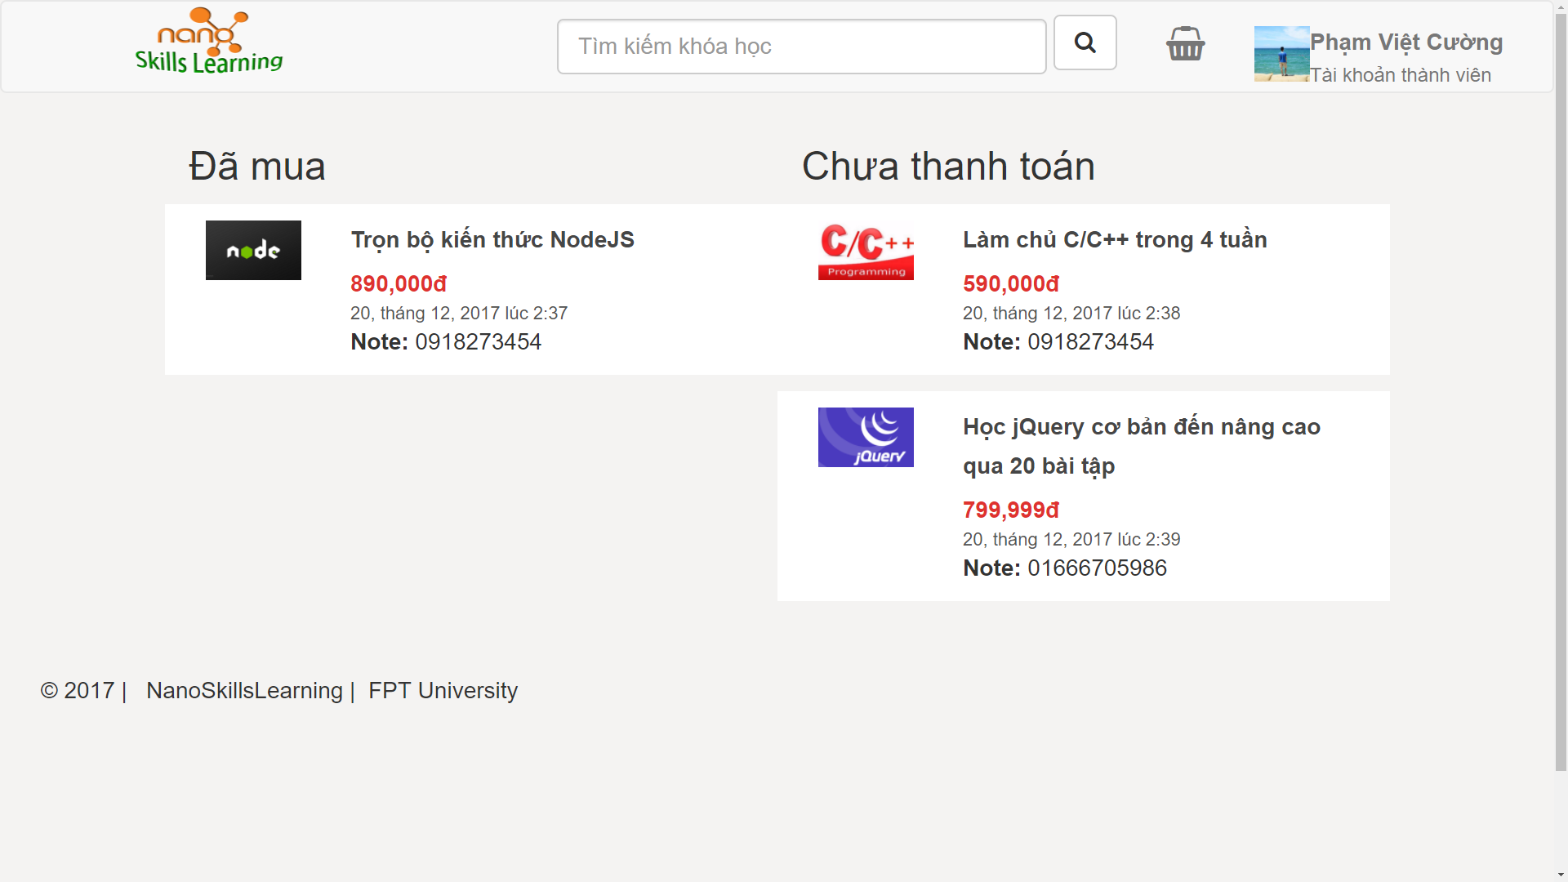
Software Requirement Specification
Student
History of payment

Slide 31
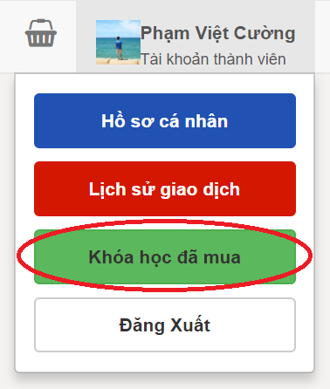
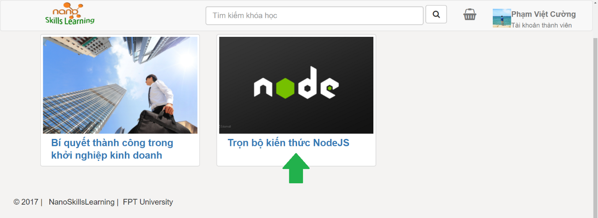
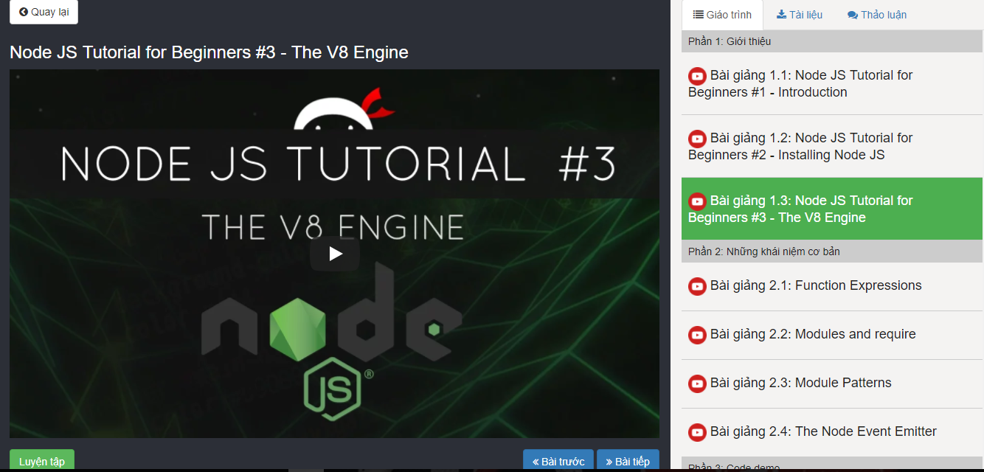
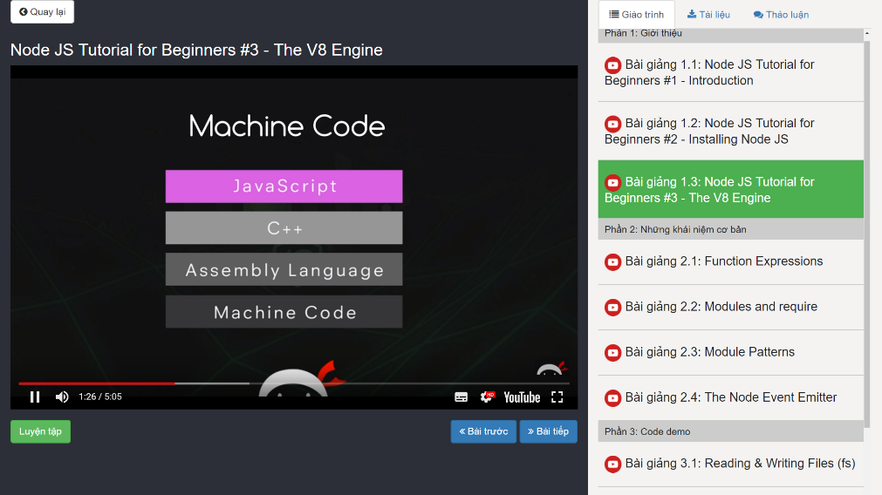
Software Requirement Specification
Student
Learn a course

Slide 32
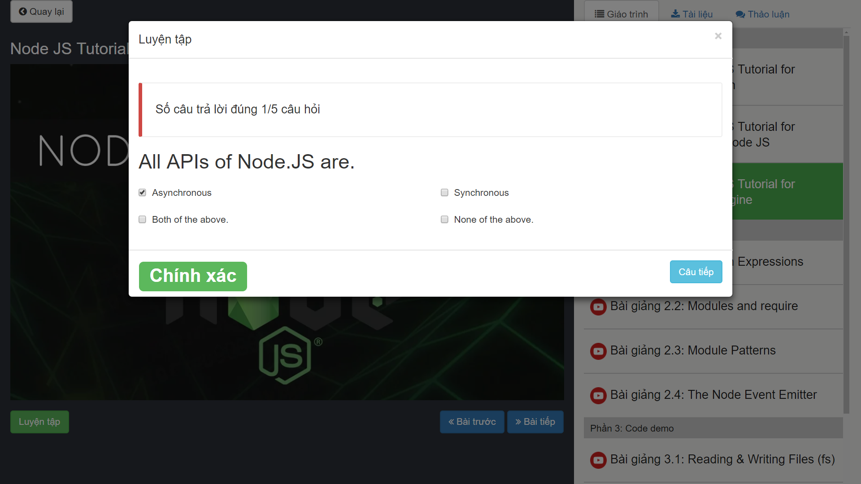
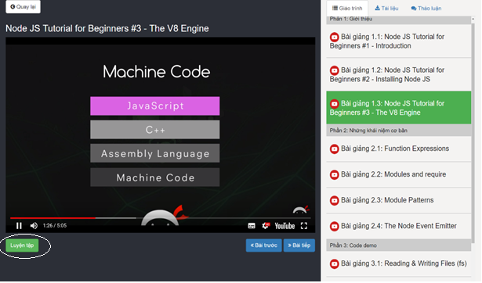
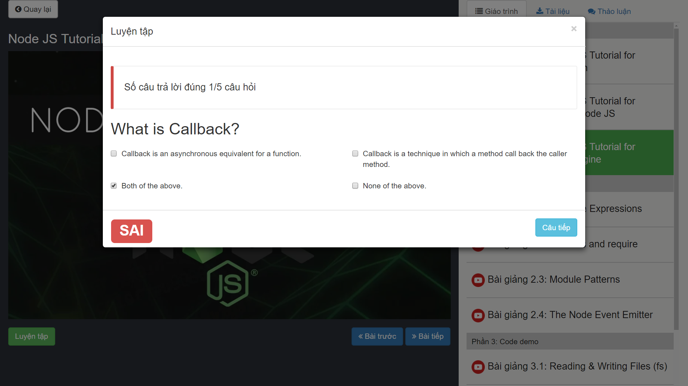
Software Requirement Specification
Student
Lesson’s Practice

Slide 33
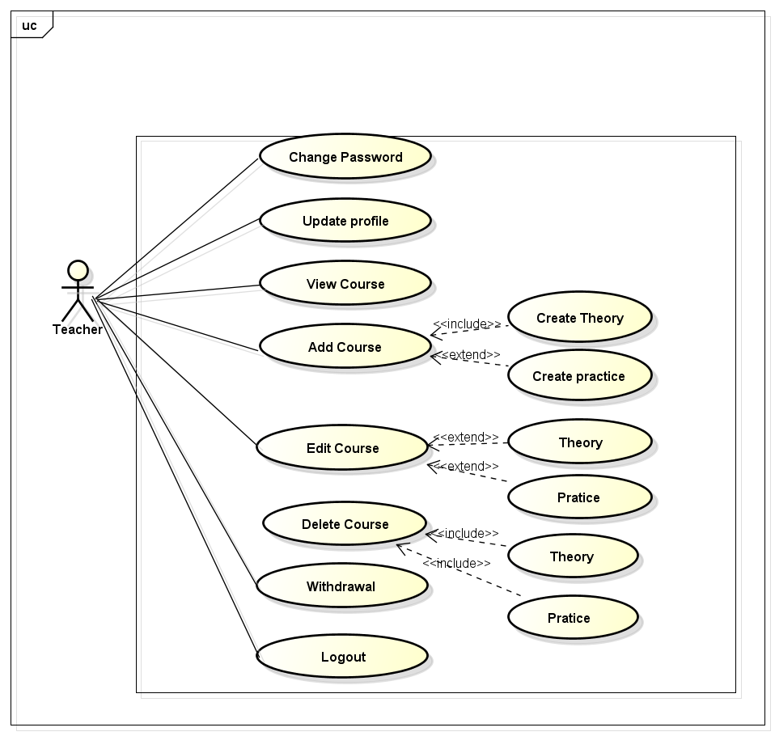
Software Requirement Specification
Teacher
Teacher use case diagram

Slide 34
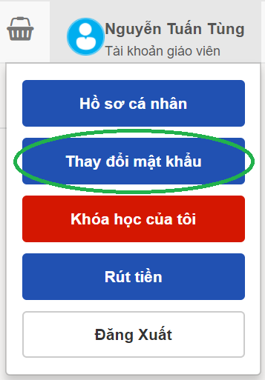
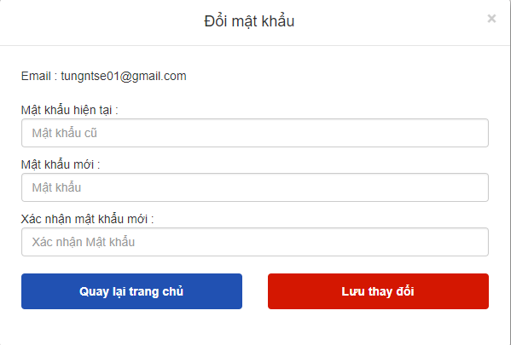
Software Requirement Specification
Teacher
Teacher change password

Slide 35
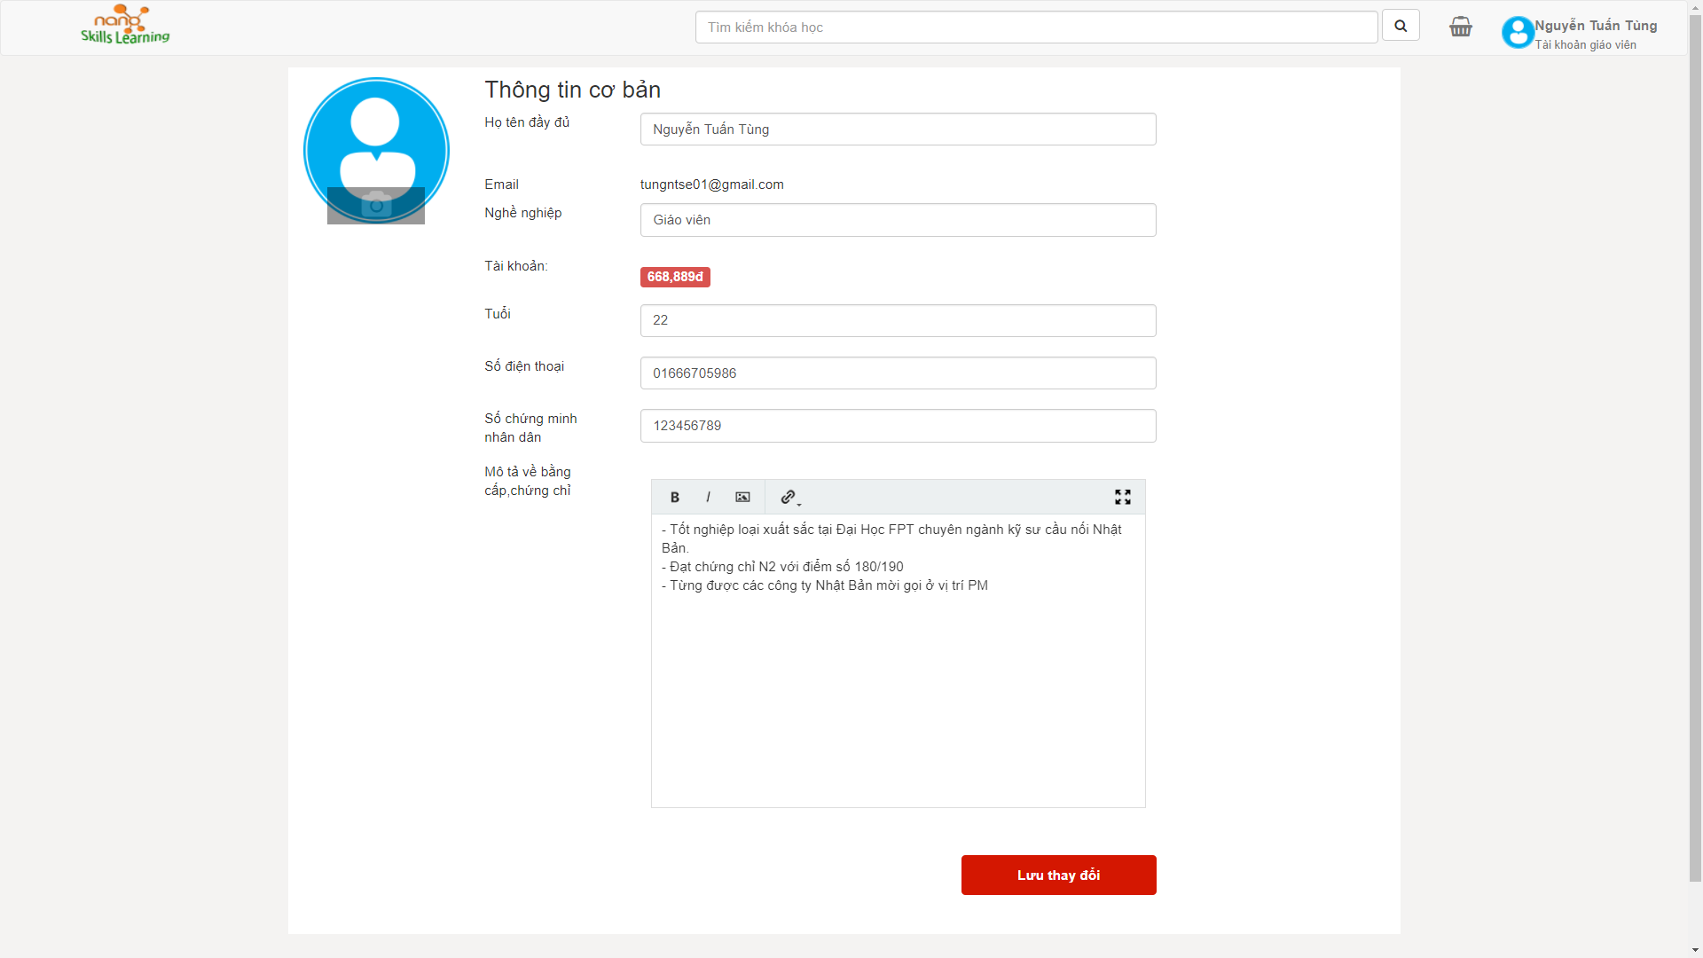
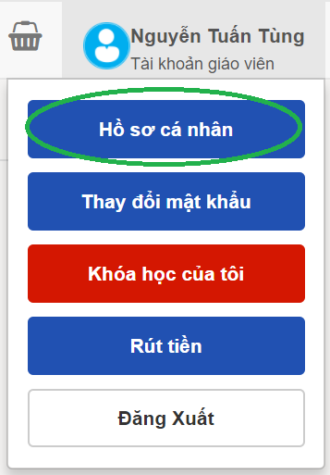
Software Requirement Specification
Teacher
Teacher’s profile

Slide 36
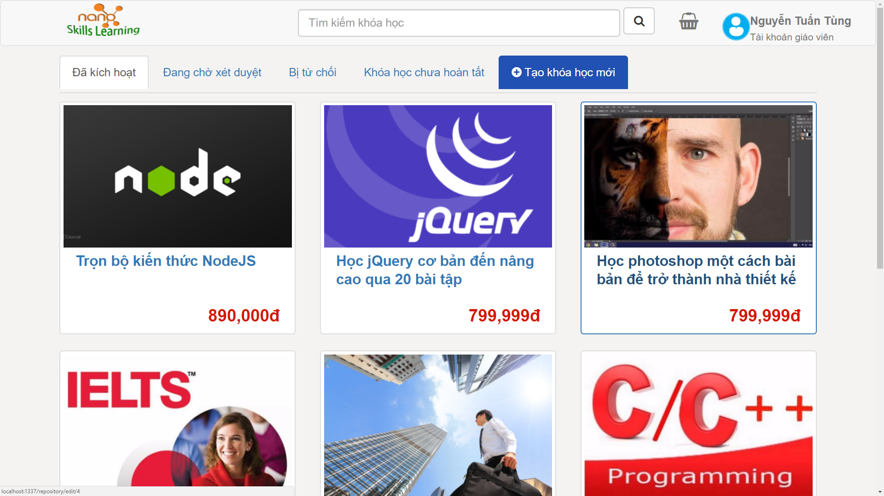
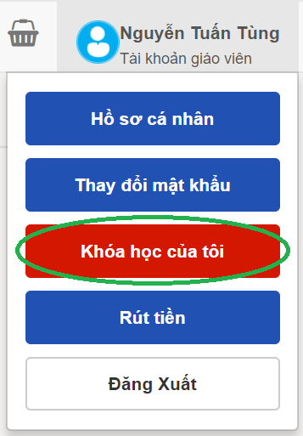
Software Requirement Specification
Teacher
Teacher’s course

Slide 37
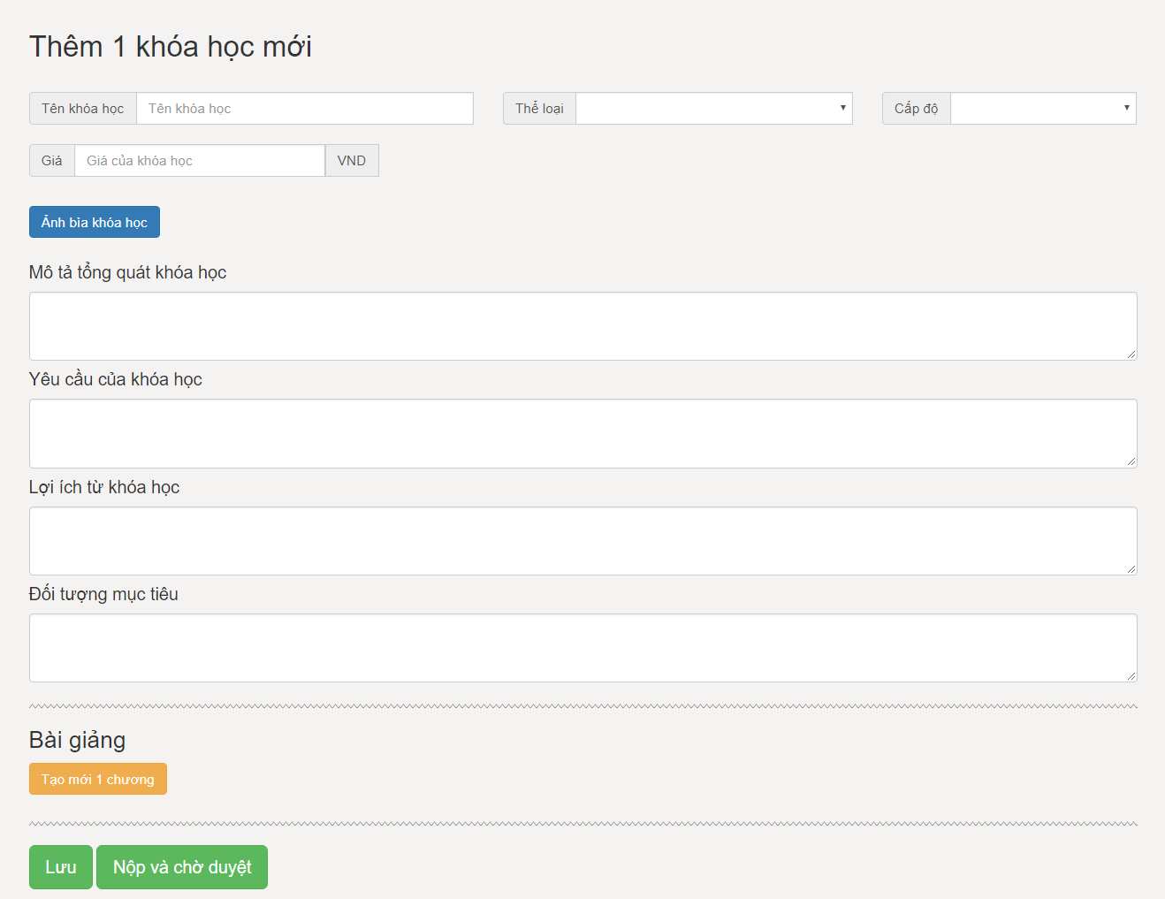
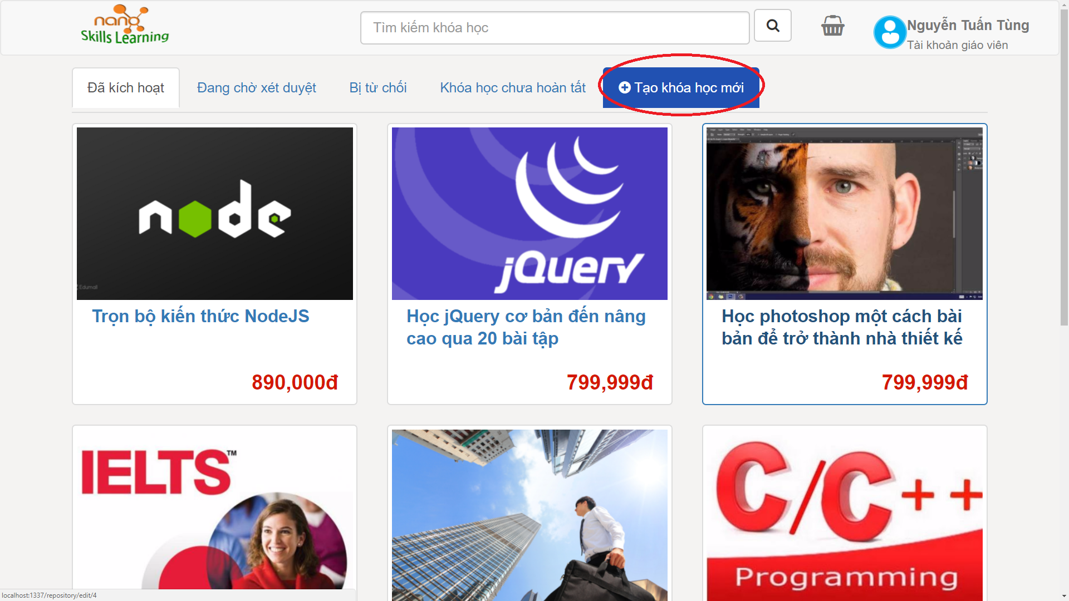
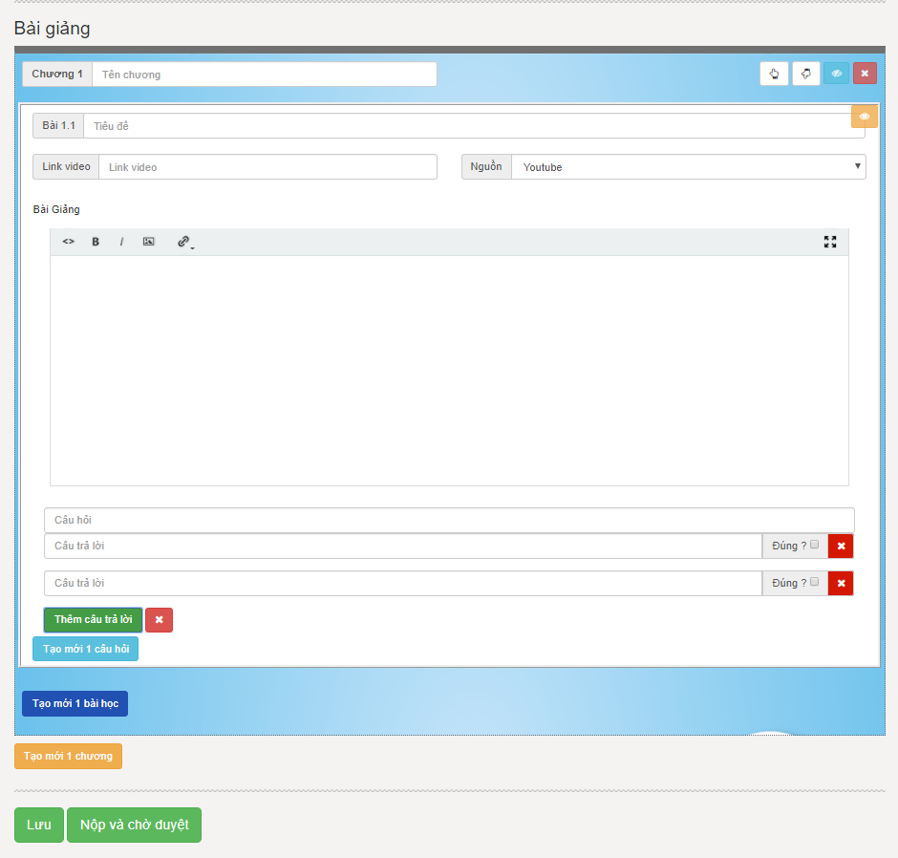
Software Requirement Specification
Teacher
Teacher add course

Slide 38
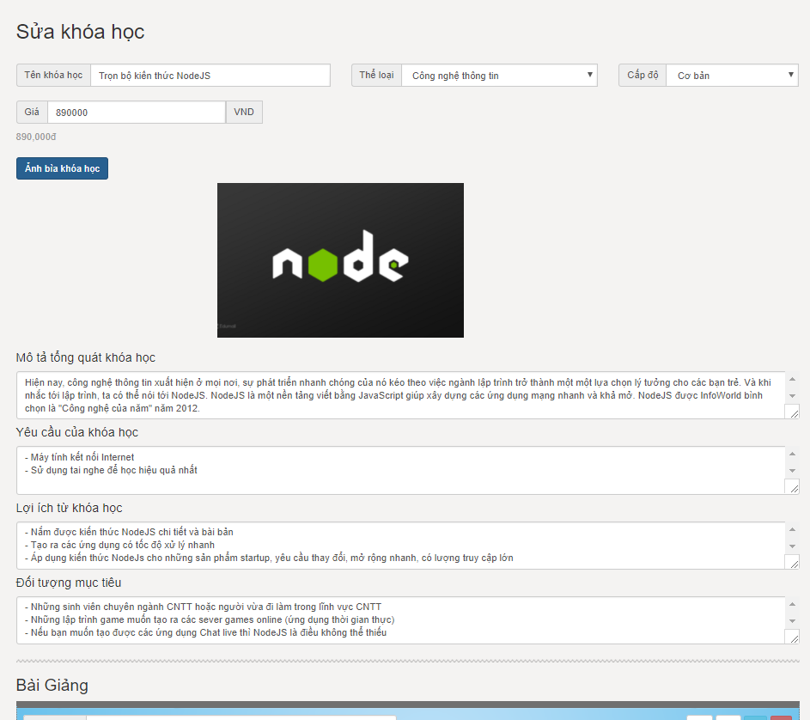
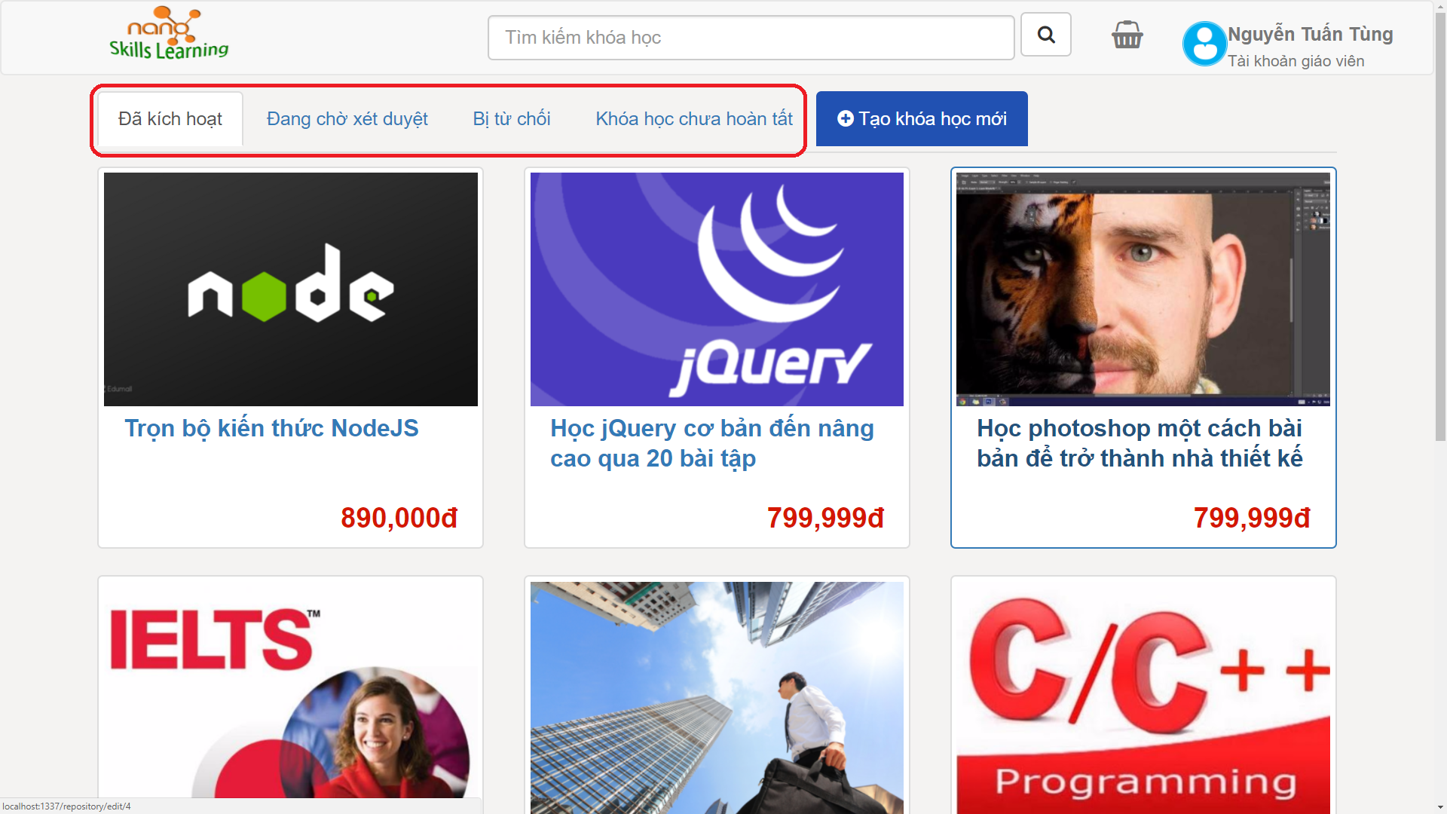
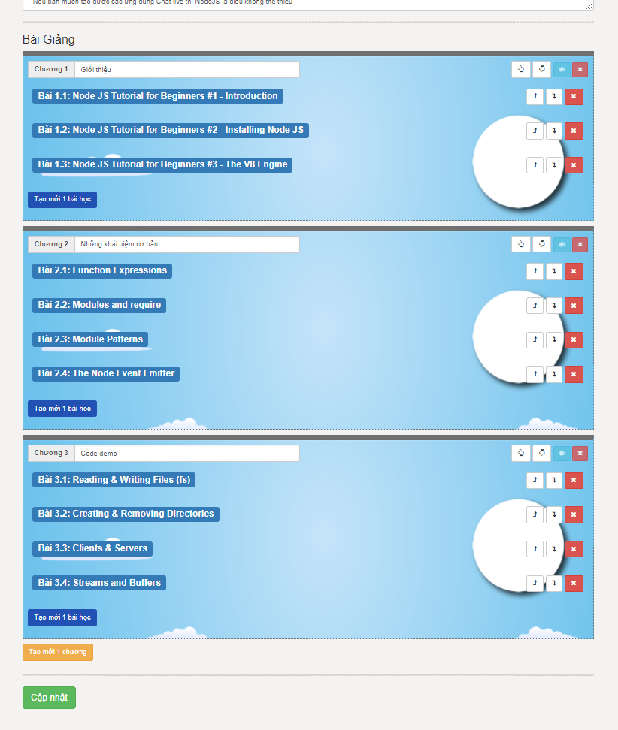
Software Requirement Specification
Teacher
Teacher edit course

Slide 39
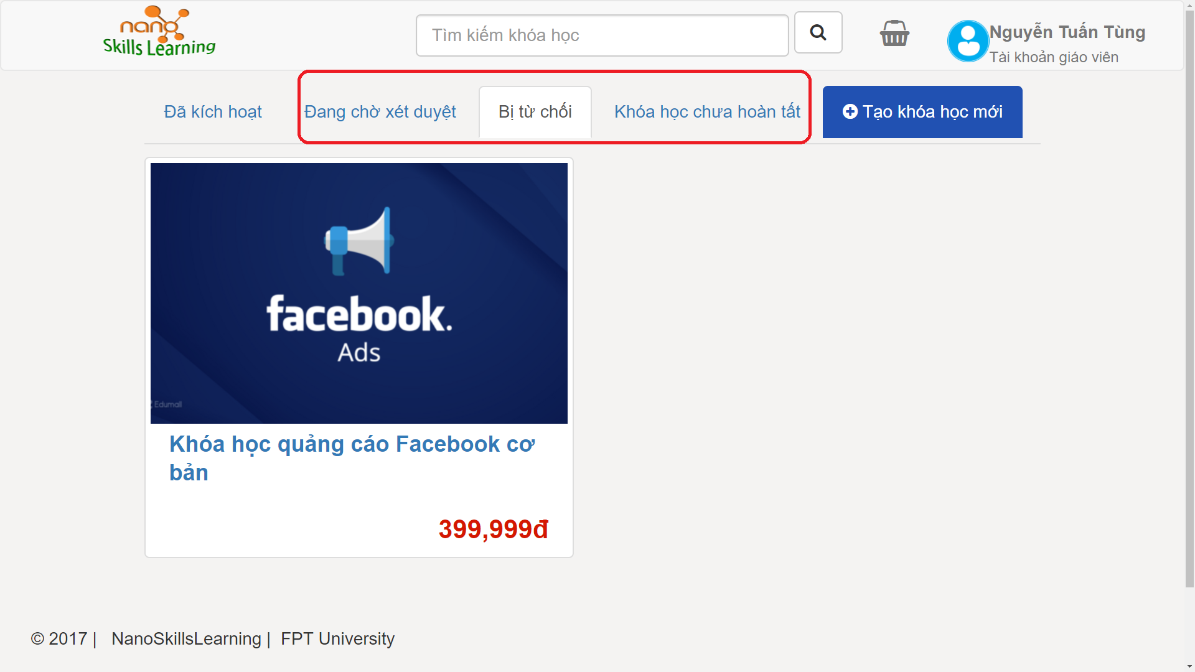
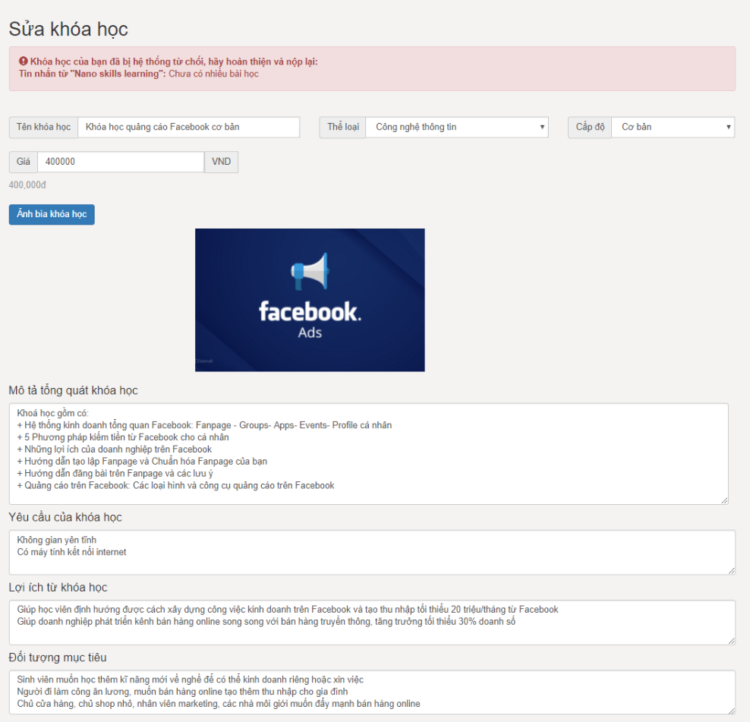
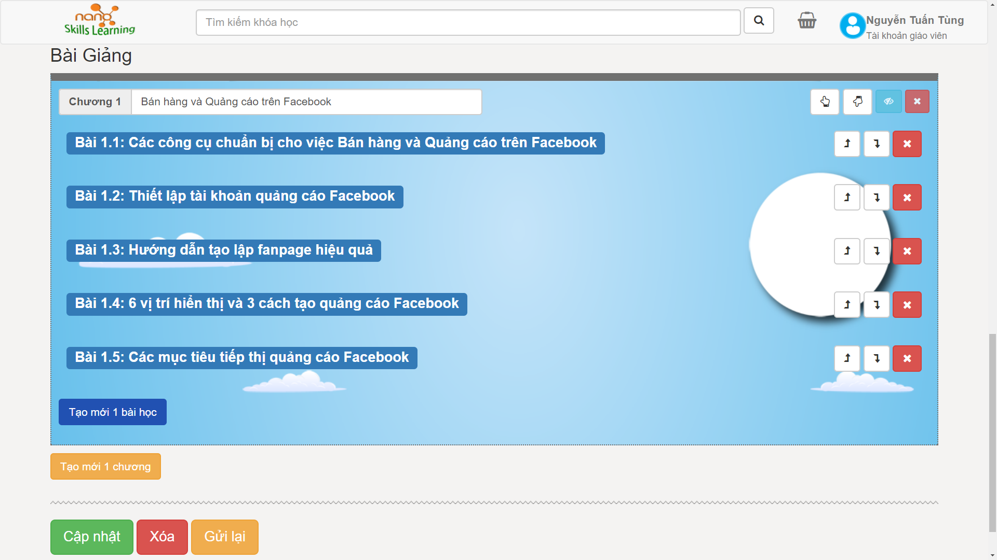

Software Requirement Specification
Teacher
Teacher delete course

Slide 40



Software Requirement Specification
Teacher
Withdrawal

Slide 41

Software Requirement Specification
Admin
Admin use case diagram

Slide 42

Software Requirement Specification
Admin
Admin’s home screen

Slide 43


Software Requirement Specification
Admin
Approve Course

Slide 44


Software Requirement Specification
Admin
Approve Teacher

Slide 45




Software Requirement Specification
Admin
Subject Management

Slide 46




Software Requirement Specification
Admin
Level Management

Slide 47


Software Requirement Specification
Admin
Course Management

Slide 48


Software Requirement Specification
Admin
Transaction

Slide 49

Software Requirement Specification
Non – Functional Requirement
Usability
Interface should be beauty, simple, easy-to-use, clear.
The short, easy steps make it easy for actor to interact with the system immediately after training.
Provide an introduction to support users.

Slide 50


Software Requirement Specification
Non – Functional Requirement
SUPPORTABILITY
Easy to maintain.
The website deployment and upgrade will be specified in the Installation Guide documents.

Slide 51

Software Requirement Specification
Entity Relationship Diagram
Notes:
Khi muốn tạo một cơ sở dữ liệu thì đầu tiên người developer sẽ phân tích yêu cầu người dùng, để xác định các đối tượng cũng như môi quan hệ giữa các đối tượng. Để tạo thành một view logic cho hệ thống

Slide 52
SOFTWARE DESIGN DESCRIPTION ソフトウェア要件仕様書

Slide 53




Software Design Description
Backend
Sailsjs Framework
MySql
Frontend
Technology & Reason
Boostrap
Angularjs
Notes:
Sails JS: Là framework của nodejs Ưu điểm : Áp dụng mô mình MVC thuận lợi cho quá trình phát triển web. Tích hợp ORM waterline, thuận tiện cho việc khai báo và quản lý data dễ dàng hơn.

Slide 54

Software Design Description
System Architecture
System Overview Diagram
システムの概要
Notes:
Đây là view hệ thống NSL : cho thấy sự liên kết giữa các thành phần của hệ thống đến với người dùng cũng như các service từ google hay facebook

Slide 55

Software Design Description
System Architecture
Component Design
コンポーネントの設計

Slide 56

Software Design Description
SQL Database Design
SQLデータベース設計
Database
Design
Notes:
Sau khi có được sơ đồ ERD thì chúng ta sẽ tiến hành tạo một cơ sở dữ liệu
Cơ sở dữ liệu gồm 12 bảng :
Bảng được hoàn thiện dần trong quá trình phát triển hệ thống

Slide 57

Software Design Description
Add course class diagram クラス図
Class
Diagram

Slide 58

Software Design Description
AddCourse sequence diagram
( シーケンス図)
Sequence
Diagram

Slide 59



SOFTWARE TESTING - ソフトウェアテスト

Slide 60
Testing
01
Test Plan
02
Test Cases
03
Test Report

Slide 61

Testing
Test Plan
Testing Strategy
Test stage:
Unit test
Integration test
System test
Test type:
Function test
GUI test
Data test
V-Model

Slide 62



Testing Environment and Tools
Testing
Test Plan
Microsoft Windows 10 Professional 64 bit
Google Chrome
Mozilla Firefox
Microsoft Office Word, Excel 2016

Slide 63

Testing
Test Plan
Testing Process
FPT Software Testing Process

Slide 64

Testing
Test Case
Unit Test

Slide 65

Testing
Test Case
Integration Test

Slide 66

Testing
Test Case
学んだ教訓
System Test

Slide 67

Testing
Defect bug

Slide 68

Testing
Test Report
Unit Test Report

Slide 69

Testing
Test Report
Integration Test Report

Slide 70

Testing
Test Report
System Test Report

Slide 71





Lesson Learn - 学んだ教訓
New Technology
Management Skill
Requirements analysis
Teamwork
Writing Document Skill

Slide 72




Demo - デモ

Slide 73


Q&A - 質問と回答

Slide 74

Thanks for watching!
ご清聴でありがとうございます。
43

